Slide 1


Tyrix Packaging Solutions
Design Beyond Expectations

Slide 2

We Think. We Build. We Deliver.
Tyrix Packaging Solutions delivers innovative, sustainable packaging systems that protect products, improve supply chain efficiency, and support smarter, cost-effective logistics operations.
Supply Chain Efficiency
Save Resources
By optimizing the complete packaging journey—from raw materials to end delivery—we help organizations minimize waste, reduce environmental impact, and achieve sustainable cost savings.
We design innovative packaging solutions that help businesses minimize material consumption, reduce freight expenses, and achieve their sustainability goals.
Safe Transit
Returnable Packaging
Designed for maximum protection and reliability, our packaging solutions ensure every product arrives in perfect condition—protecting critical components, precision surfaces, and delicate assemblies every step of the way.
We develop sustainable, reusable packaging solutions with optimized reverse logistics processes that minimize waste, extend packaging life cycles, and lower overall operating costs.

Slide 3


Vision & Mission
Vision
We develop innovative packaging and logistics solutions that
empower customers to streamline operations, improve efficiency,
and maximize resource utilization across their supply chains.
Mission
To drive continuous innovation in packaging and logistics, improve
process efficiency, and foster a culture of learning that benefits
both our employees and customers.

Slide 4
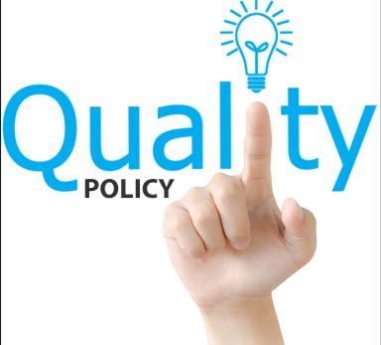
Quality Policy
Right Quality & Quantity
Delivery of the right quality and quantity — on time, every time — is the
foundation of our customer commitment.
Continual Improvement
Continual improvement in all aspects of our operations, from product design to production process and customer service.

Slide 5
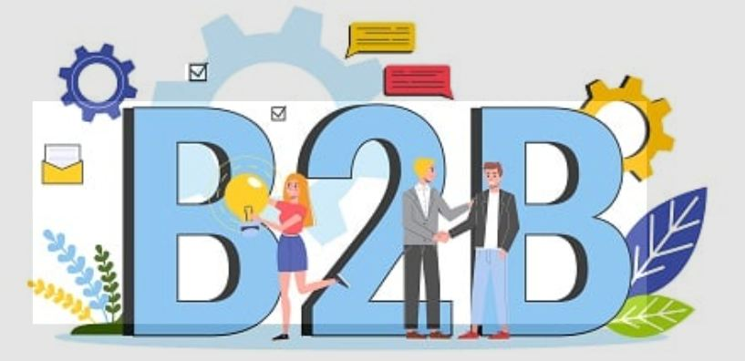
Results-Driven. Relationship-Led
Tyrix differentiates itself through a consultative, engineering-first approach. We don't just manufacture packaging — we study your supply chain, understand your product, and engineer the right solution from the ground up.
Customer-Driven Design
Corrosion Protection
We create packaging solutions from customer
concepts and Value Engineering proposals,
helping improve existing methods and support
new product requirements.
We design cost-effective, right-fit packaging
solutions and develop customized corrosion
protection systems tailored to the specific surface
requirements of each product.
Complete Supply Chain Study
Returnable & Poka-Yoke
By assessing the entire supply chain, we
develop and propose packaging solutions at
every level—primary, secondary, and
tertiary—to enhance product protection,
operational efficiency, and logistics performance.
We develop returnable packaging with reverse
logistics and Poka-Yoke features to improve
efficiency and eliminate assembly-line errors.

Slide 6
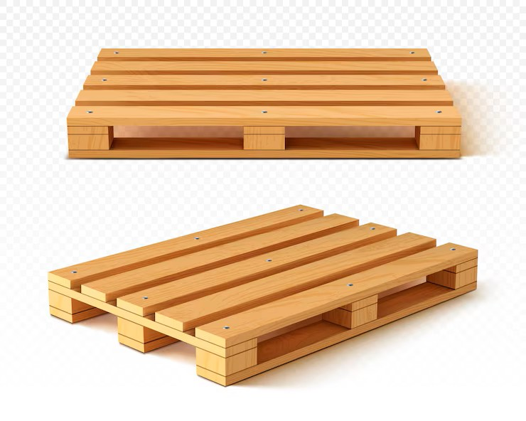
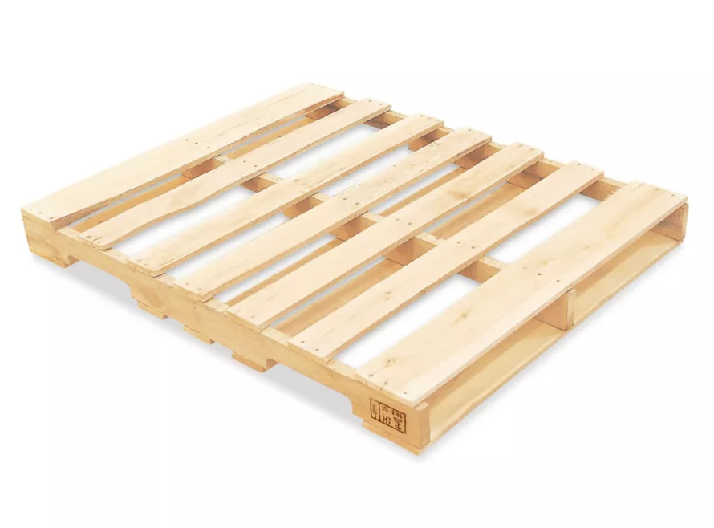
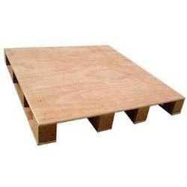
Standard Pallets
Tyrix's standard pallets are engineered by carefully considering all relevant loading factors — static loads, dynamic forces, and stacking requirements — and are optimized for specific applications to safely handle expected loads throughout the supply chain.
BLOCK PALLET
STRINGER PALLET
PLYWOOD PALLET

Slide 7
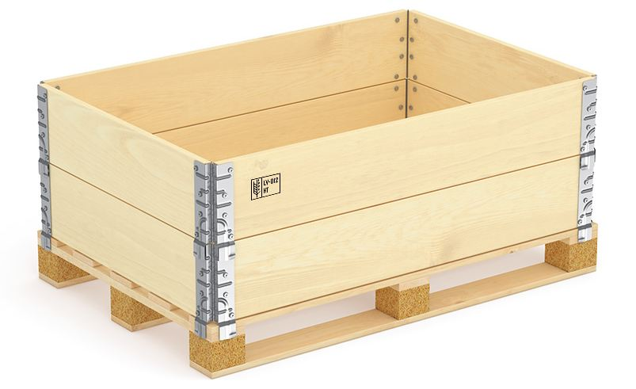
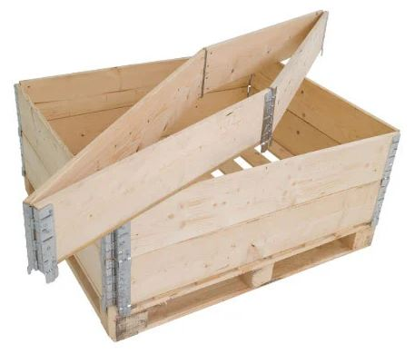
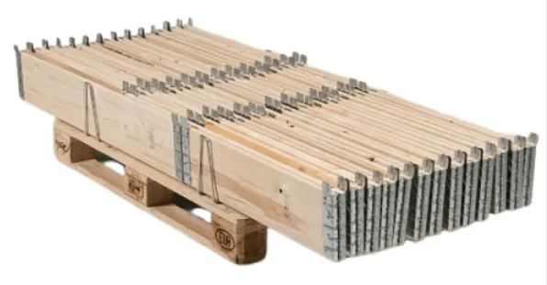
Pallet Collar
Pinewood pallet collars are among the most versatile packaging solutions available — used extensively across manufacturing, distribution, warehousing, and international shipping. They convert a standard pallet into a secure, stackable container in seconds, without tools.
Key Specifications
Size Range : Min: 600×600×195 mm
Max: 3,600×1,800×390 mm
Compression Load : 4,500 Kgf
Durability : 10-year service life under normal
use conditions
Space Saving : 87% space reduction when folded
flat for return logistics

Slide 8
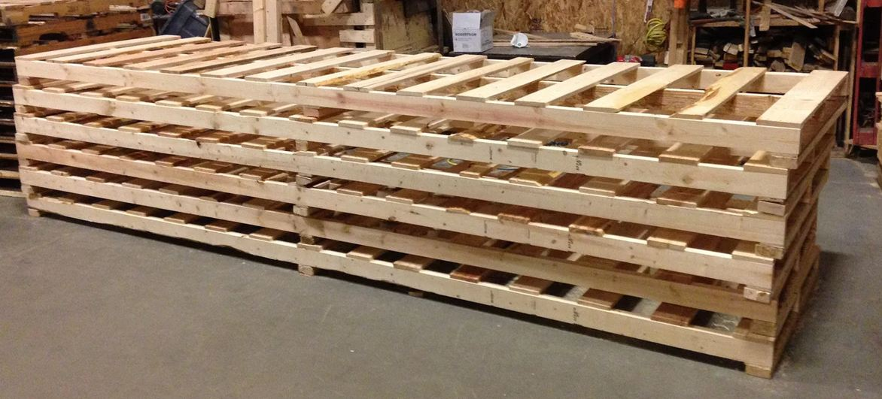
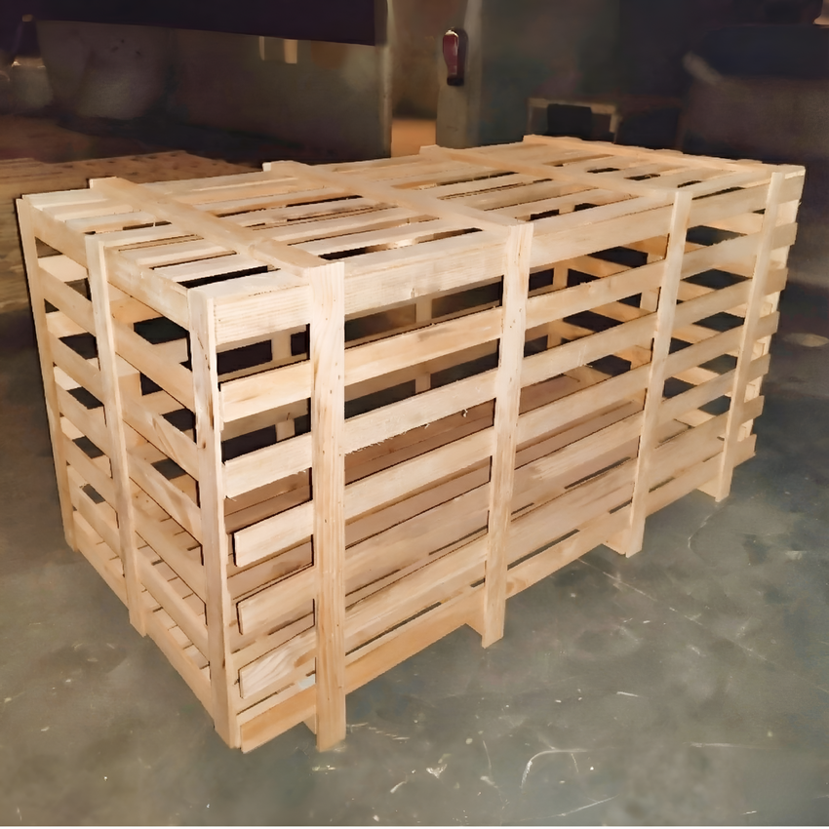
Heavy-Duty Pallets & Boxes
Heavy-Duty Pallets
Heavy-Duty Boxes
Specifically engineered to handle heavier loads and
withstand the most rigorous handling conditions —
far exceeding the capacity of standard pallets.
Robust and secure enclosures for heavy, delicate, or
high-value items — ensuring safe storage and
transportation even in demanding international freight
conditions.
Max Length : 16 Feet
Max Load : 10+ Tons
Max Length : 40 Feet
Max Load : 18+ Tons

Slide 9
C-Crate & S-Box
C-Crate (Collapsible Crate)
S-Box (Stud Box)
Collapsible wooden crates offer significant
space-saving advantages over traditional fixed
crates. When empty, they fold flat for efficient
return shipping — dramatically reducing reverse
logistics costs and storage footprint. A highly
practical and reusable packaging choice for
businesses with high-volume distribution needs.
The Stud Box is a practical, versatile alternative to
traditional plywood boxes. It provides full collapsibility
and easy handling without sacrificing the structural
strength required for heavy-duty industrial use —
making it ideal for assembly line feeding and
returnable packaging programs.

Slide 10
Machinery & Equipment
With imported Italian machinery, Tyrix maintains the highest standards of quality and dimensional accuracy. All machines are equipped with integrated dust collection mechanisms, ensuring a clean, dust-free production environment that protects both product quality and worker safety.
Panel Saw
Band Saw
High-precision panel saw with integrated dust collector for clean, accurate panel cutting.
Vertical industrial band saw with built-in dust collection for clean profile cutting.
Planning M/C
Combi Planner
Industrial planning machine with dust collector for smooth, precise surface preparation.
Multi-function combi planner with dust collection — combining multiple operations in a single pass.
Vertical Drilling
Riveting M/C
Precision vertical drilling machine for accurate hole placement on all pallet and crate components.
Industrial riveting machine for secure, consistent assembly of pallet collar hinges and fittings.

Slide 11
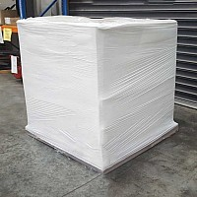
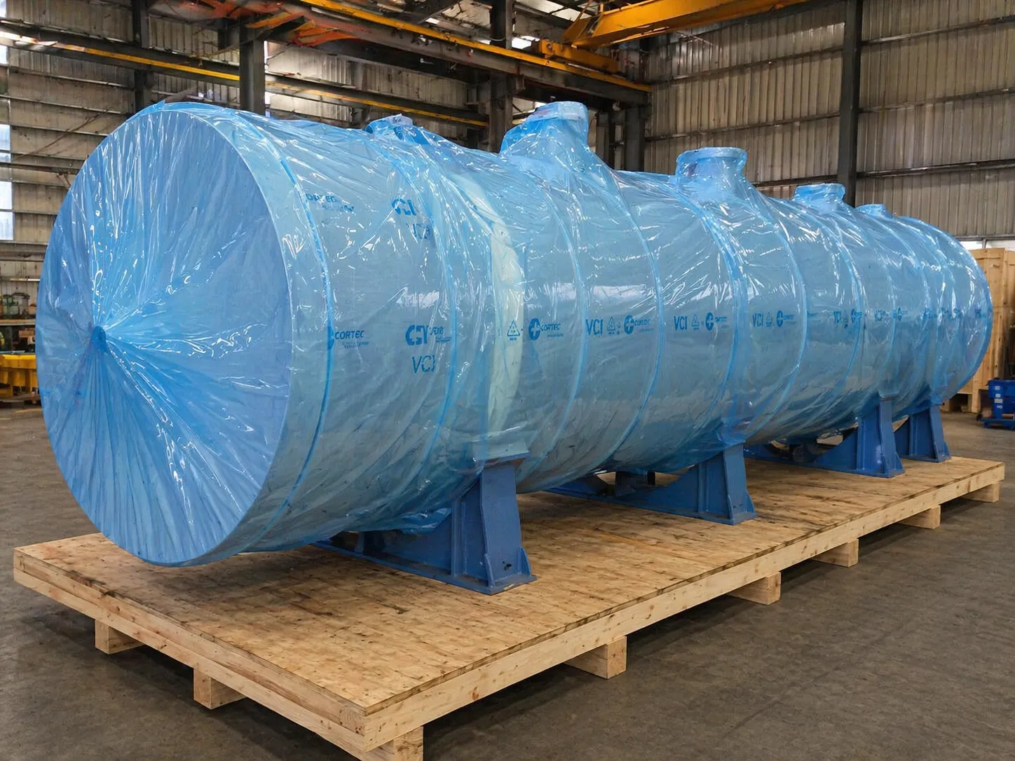
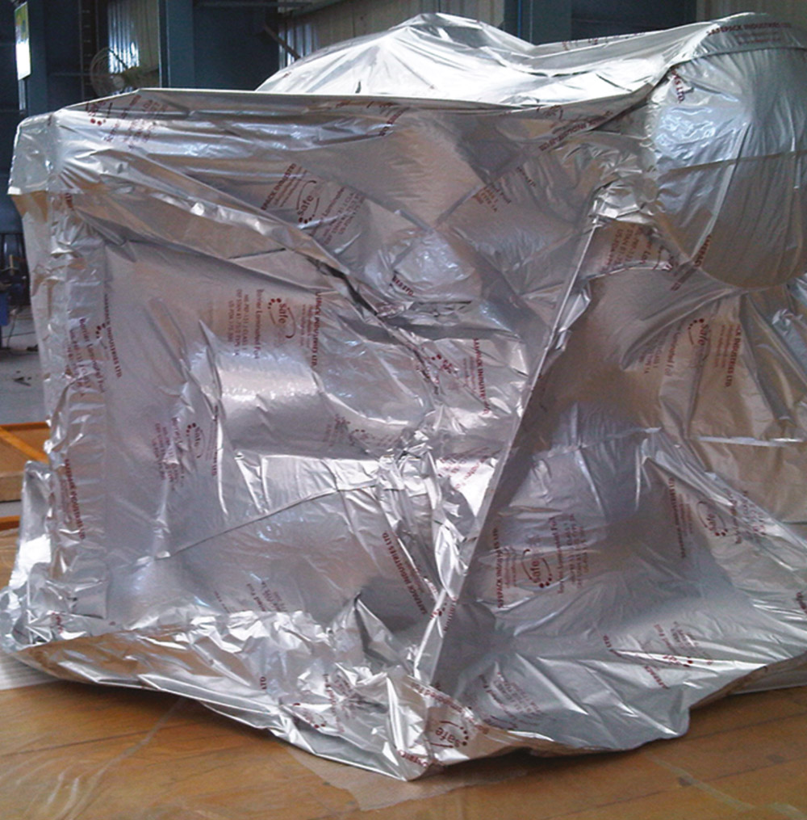
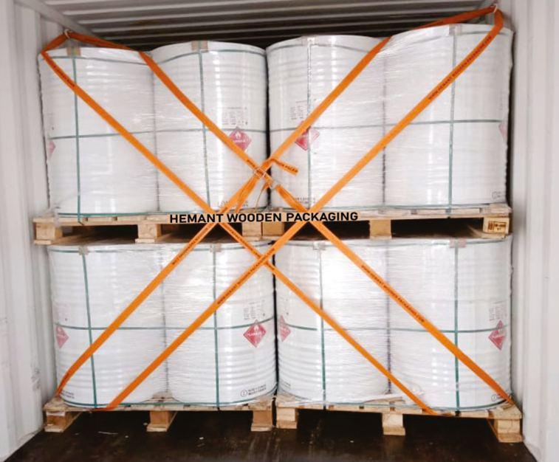
Protective Packaging for Transport & Storage
Tyrix provides a comprehensive suite of protective packaging solutions engineered to safeguard products during international transit and long-term storage — addressing moisture, corrosion, movement, and contamination risks.
Heat Shrink Wrapping
VCI Solutions
Vacuum Packaging
Lashing
Tight plastic wrap applied
over products and pallets for
moisture, dust, and tampering
protection during transport
and outdoor storage.
Vapor Corrosion Inhibitor
packaging that actively
prevents corrosion on metal
surfaces during storage and
long-distance sea or air
transit.
Vacuum-sealed silver barrier
material that protects
contents from moisture,
oxygen, and atmospheric
contamination — ideal for
precision components.
Secure load lashing with
industrial-grade straps
inside shipping containers
to prevent any movement,
shifting, or tipping during
ocean transit.

Slide 12


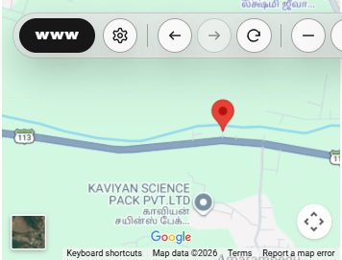
Get In Touch
Contact Tyrix Packaging Solutions
Visit Us
No.1/54, Sriperumbudur Main Road,
Amerambedu Village, Kundrathur Taluk,
Kanchipuram District, TamilNadu 602109, India
Call Us
📞 +91 9566038044
📞 +91 9841322495
We Look Forward to the Opportunity.

